Slide 1
CS 152B Final Project: Piano Simulation
Alberto Diaz
Evan He
Brandon Truong

Slide 2
Outline
Project Introduction
Real-World Constraints
Industry Standards
Costs
Project Description
Implementation Details
Rubrics/Conclusions
Demonstration

Slide 3
Project Introduction
We propose building a piano simulation using the FPGA, PMOD keypad, PMOD AMP2, and VGA Display
Used for entertainment, can practice simple songs one note at a time

Slide 4
Real-World Constraints
Limited Options for IO: Keypad as input is limited to one key per row
difficult to map to actual piano keys
can’t properly play chords
might be able to use keyboard? more powerful input source would solve this problem
Synthesizing genuine piano sounds is much more difficult than simple triangle waves, which is what we use in this project

Slide 5
Industry Standards
GPIO (General Purpose Input Output) Interface for AMP2
VGA uses standard 640X480 resolution with 60Hz refresh rate
Use Digilent IP Cores designed to work with MicroBlaze
AMP2
Pmod KYPD
Simulate standard Piano layout

Slide 6
Costs
Not a lot of resources available for audio
to get genuine piano sound, need to invest more time to generating nicer waves
FPGA (Basys3) is expensive compared to similar hardware such as Arduino
maybe even more expensive than cheap piano keys

Slide 7
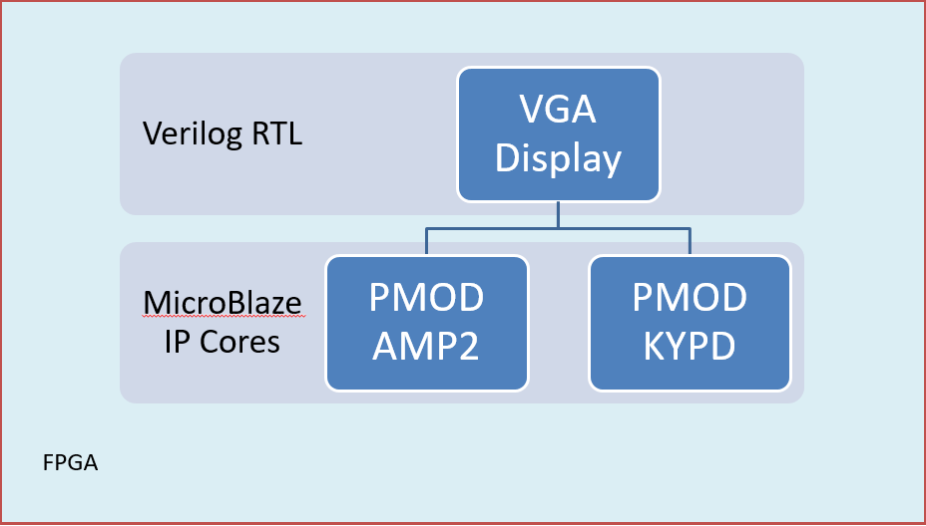
Project Description

Slide 8
Algorithms
Detail the algorithms used in the project. Relate these algorithms to current standards of use
Explain the video processing algorithm used, and the trade off with other algorithms
Explain the communication between hardware and software.

Slide 9
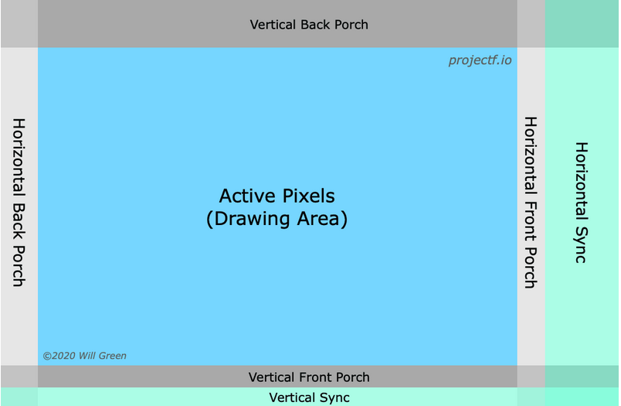
Algorithms
VGA Algorithm
scan pixel by pixel from left to right and top to bottom

Slide 10
Algorithms
KYPD Algorithm
Poll for key presses from PMOD KYPD
determine which key was pressed
set frequency for AMP2
send to VGA module via AXI_GPIO
start short counter to count how long ago a button was pressed
key stays “on”, need to manually turn off AMP2 and VGA

Slide 11
Hardware
VGA implemented using Verilog, added in to block diagram as RTL
Chose to implement in Verilog because of existing demos that were easily adaptable

Slide 12
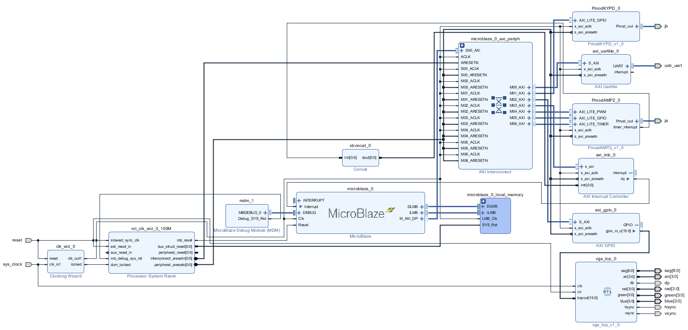
Hardware

Slide 13
Hardware

Slide 14
Software
PMOD KYPD and PMOD AMP2 are controlled by software through Digilent’s IP Cores for MicroBlaze
Chose to implement this way because Digilent already created libraries that can be used easily
Interface between KYPD and VGA facilitated via AXI GPIO
Required for interface between IP Cores and VGA RTL

Slide 15
Demonstration

